Slide 1

AUTOMATIC
ROOM
TEMPERATURE
CONTROLLER
USING ARDUINO

Slide 2

TEAM MEMBERS
SANJIL K C
- 20BCE1855
DEVARINTI DHAPATLA PUNEETH REDDY - 20BCE1852
RAJAN SINGH
- 20BCE1780

Slide 3
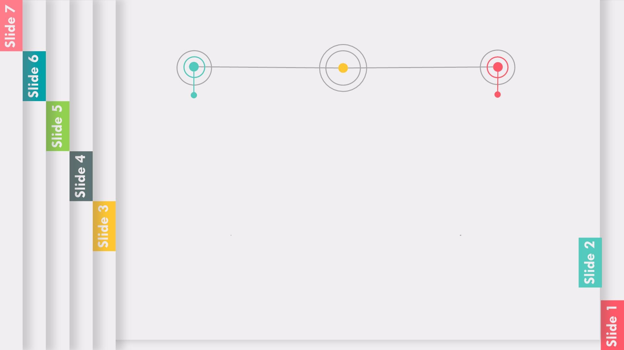
AIM
ABSTRACT
To design an automatic room
temperature control system that
maintains the temperature between
20 and 25 °C using Arduino micro
controller and temperature sensor.
The “Automatic room temperature control and
monitoring system using Arduino”.
In this process the room temperature is maintained
constantly. In which the value is set by the user the
heater and Ac turned on or off. The system will
always get the temperature from the DHT11
temperature sensor. The DHT11 temperature sensor
measures both the temperature and humidity of the
room. The value of temperature and humidity is
displayed in Liquid Crystal Display (LCD). The entire
system was controlled by the Arduino Microcontroller.
The Microcontroller senses the temperature and it
compares the data value set by the user. The
controller turns on the AC when the current
temperature is higher than the required data
temperature and the controller turns on the heater
when the current temperature is lower than the
reqquired temperature.
Ø To learn and understand Arduino
programming and program the
Arduino to operate our proposed
system.
Ø Simulate the system in “Tinkercad”
(a simulation software) and draw
out conclusion from the simulation.

Slide 4

SOFTWARE REQUIRED
Software platform TINKERCAD was used.
The circuit is designed in an TINKER CAD and
code is written and uploaded and it is simulated
for getting results for the designed circuit.
Tinkercad provided following features necessary
for our project:
Ø Creating a custom circuits using various
components like Arduino, breadboard and so
on from scratch
Ø Integrated IDE to upload the code and
program the Arduino.
Ø Simulation of the circuit.
Programming Language: C++ ( Arduino
Programming)

Slide 5

HARDWARE REQUIRED
01 ARDUINO UNO R3
06
TEMPERATURE SENSOR
(LM35)
02
03
RELAY
07 BREADBOARD
9V BATTERY
08
09
LCD 16X2
FAN
04 RESISTOR
05
CONNECTING WIRES
10 DC MOTOR

Slide 6

LEARNING
Understand the value and importance of learning a
coding language; Be able to write a simple program
in C++ with GNU Compiler; Transform a physical
input into a digital input and analyze it; Work to
complete customizable full Arduino project
autonomously, from the beginning to the end;
Understand the function of electronic sensors and
components; Learn to build your own led circuit; Plan
and design innovative and fun tools for education.

Slide 7

EXPECTED OUTCOME
The Automatic room temperature control
and monitoring system will be designed
and implemented and it will help in
regulating the room temperature and
controls the fans and AC and tracks the
humidity of the room.

Slide 8
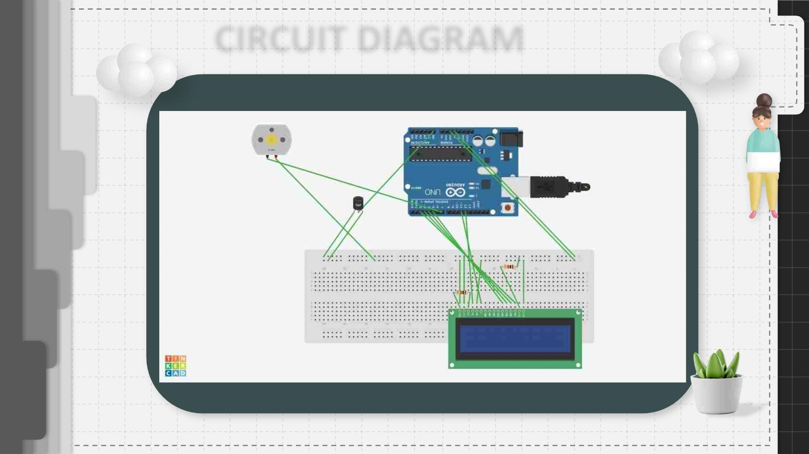
CIRCUIT DIAGRAM

Slide 9
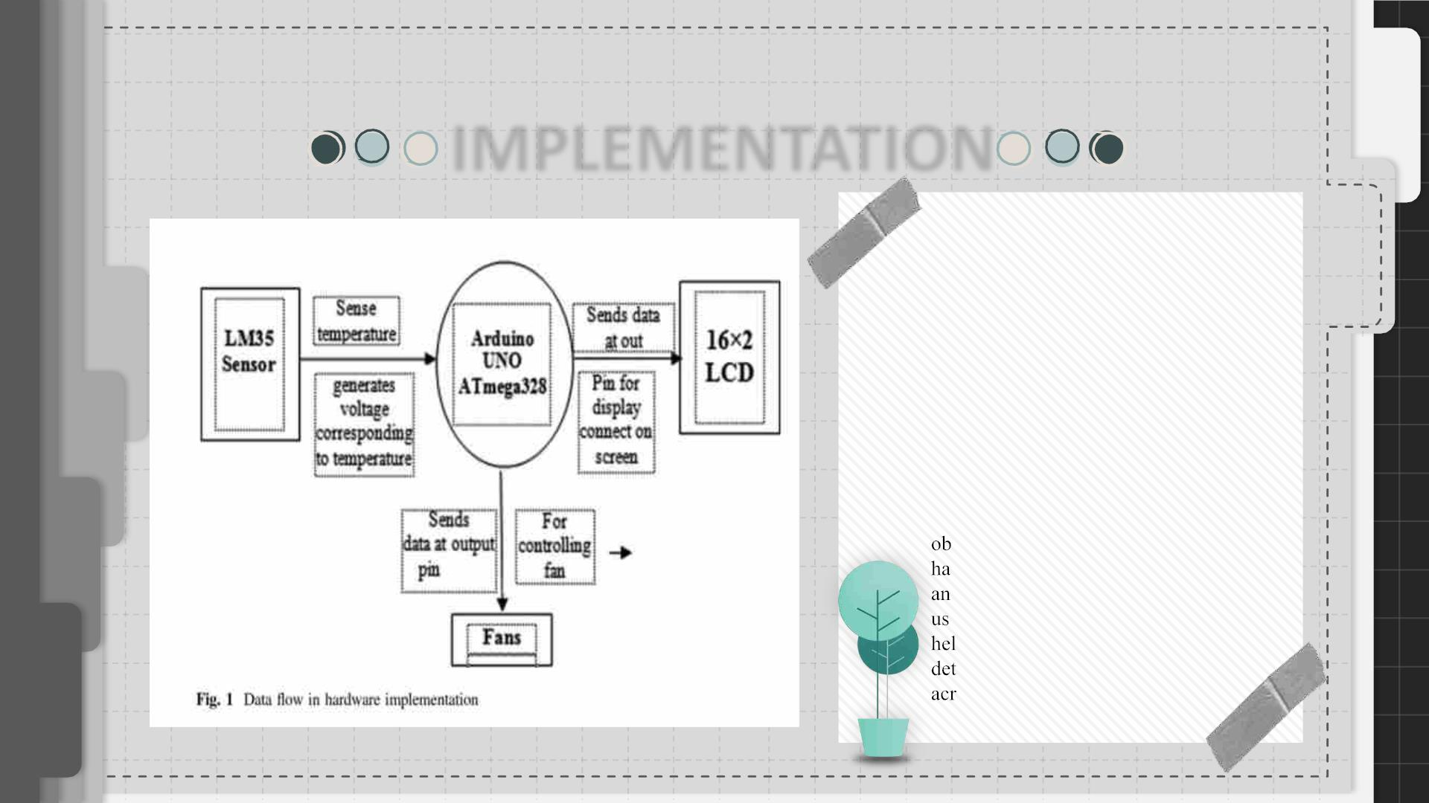
IMPLEMENTATION
Hardwareꢀ
implementationꢀ
wasꢀ
obtainedꢀ onꢀ Arduinoꢀ IDEꢀ interfacedꢀ
withꢀ P-IVꢀ computer.ꢀ Dataꢀ flowꢀ andꢀ
blockꢀ diagramꢀ ofꢀ theꢀ hardwareꢀ
implementationꢀ areꢀ shownꢀ inꢀ Figs.ꢀ 1ꢀ
andꢀ2,ꢀrespectively.ꢀFiguresꢀ1ꢀandꢀ2ꢀareꢀ
simpleꢀ andꢀ self-explanatoryꢀ whereꢀ
temperatureꢀsensorsꢀareꢀconnectedꢀwithꢀ
theꢀ helpꢀ ofꢀ Arduinoꢀ andꢀ LCDꢀ displayꢀ
ofꢀ 16ꢀ 2ꢀ matrix.ꢀ Theꢀ fanꢀ wasꢀ
additionallyꢀ connectedꢀ forꢀ coolingꢀ
mechanismꢀ soꢀ thatꢀ automaticꢀ controlꢀ
couldꢀ beꢀ achievedꢀ whichꢀ isꢀ mainꢀ
jectiveꢀ ofꢀ theꢀ proposedꢀ work.ꢀ Theꢀ
rdwareꢀdesignꢀisꢀveryꢀsimpleꢀwithoutꢀ
yꢀ circuitꢀ complexityꢀ (Fig.ꢀ 3).ꢀ Weꢀ
edꢀtemperatureꢀsensorꢀICꢀLM35ꢀthatꢀ
psꢀinꢀgeneratingꢀaꢀsmallꢀvoltageꢀforꢀ
ectingꢀ theꢀ changeꢀ inꢀ temperatureꢀ
ossꢀtheꢀtemperatureꢀsensor.

Slide 10
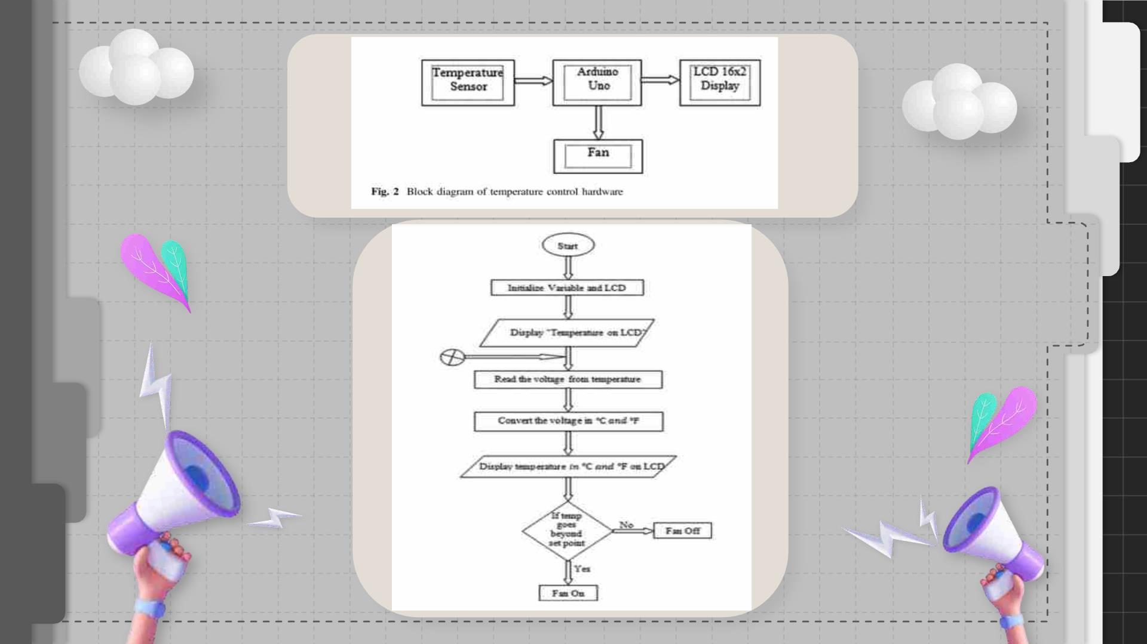

Slide 11

APPLICATION AND
WORKING
Application
WORKING
A Temperature Controlledꢀ Systemꢀ isꢀ aꢀ typeꢀ ofꢀ controlꢀ
systemꢀ thatꢀ automaticallyꢀ controlsꢀ theꢀ temperatureꢀ ofꢀ
anꢀobjectꢀorꢀanꢀarea.
The program is written in
Arduino IDE and facilitates
the display of temperature in
degree centigrade .Theꢀ
ArduinoꢀUnoꢀboardꢀfacilitatesꢀ
theꢀtemperatureꢀmeasurementsꢀ
inputꢀtoꢀtheꢀfanꢀandꢀcoolingꢀ
systemꢀON/OFFꢀthatꢀisꢀ
Weꢀ commonlyꢀ useꢀ temperatureꢀ controlꢀ systemsꢀ in Air
Conditioners, Refrigerators, geysers,ꢀ
modern
gadgets and smart homes etc.ꢀ whereꢀ theꢀ
temperatureꢀisꢀautomaticallyꢀadjustedꢀasꢀper theꢀinputꢀ
settings.ꢀ Inꢀ orderꢀ toꢀ implementꢀ aꢀ temperatureꢀcontrolꢀ
system,ꢀ weꢀ needꢀ aꢀ temperatureꢀ sensor,ꢀ aꢀ controller,ꢀ
andꢀaꢀcoolingꢀsystem.
automaticallyꢀdoneꢀbasedꢀonꢀ
variedꢀvaluesꢀofꢀtemperature.

Slide 12
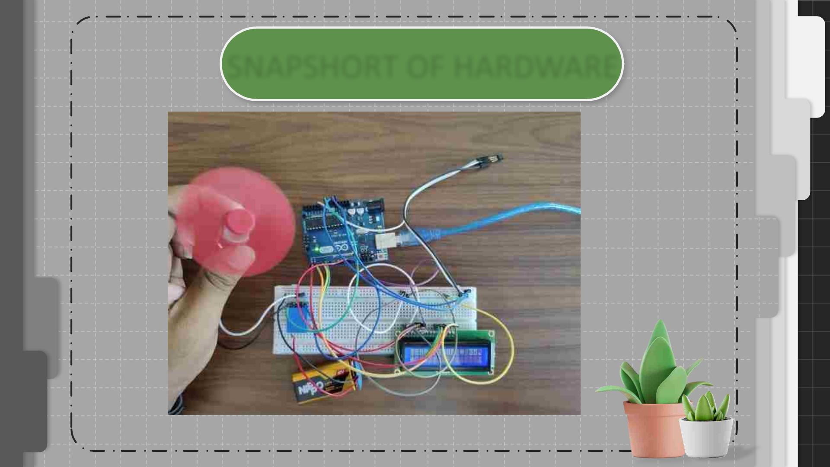
SNAPSHORT OF HARDWARE

Slide 13
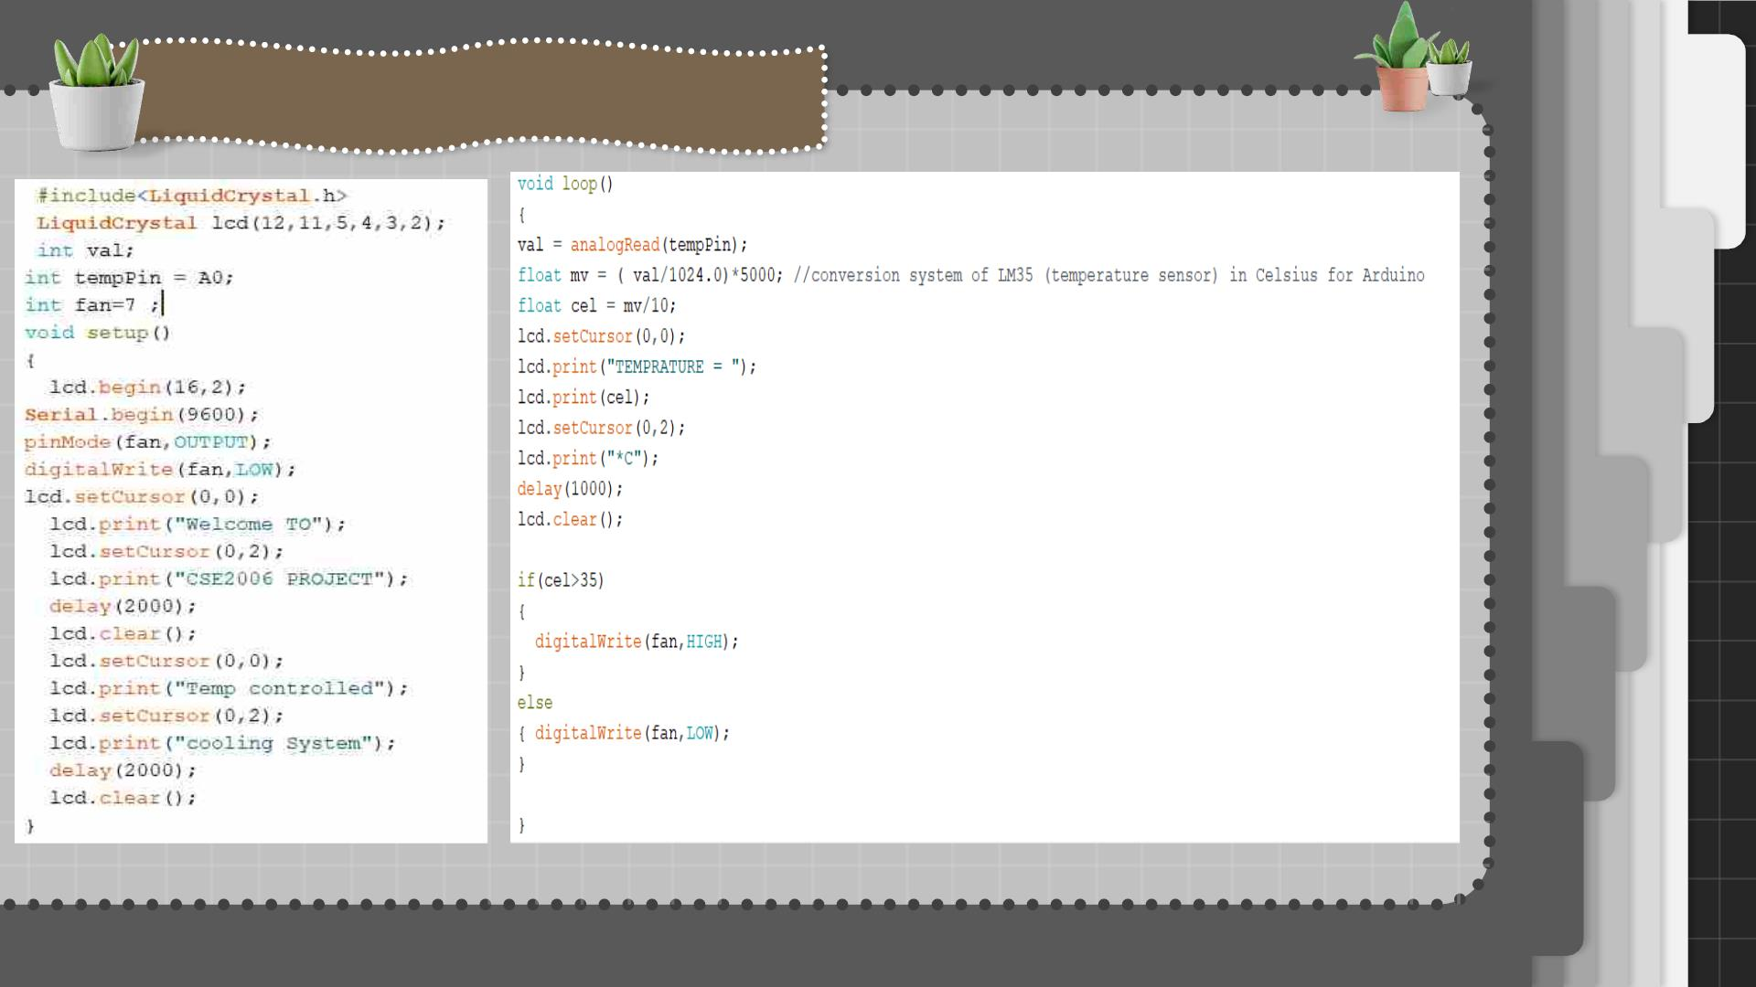
SNAPSHOT OF CODE

Slide 14

CONCLUSION
An automatic room temperature control system
was designed and implemented successfully. The
system can easily regulate the temperature within
a room containing a fan and heater. The system is
fairly efficient and robust. The system is simple
and could be practically implemented in
temperature control in home, offices and other
places.

Slide 15

Whenꢀ
temperatureꢀ
exceedsꢀ theꢀ limit,ꢀ aꢀ
callꢀ willꢀ beꢀ dialed toꢀ
theꢀ respectiveꢀ givenꢀ
Weꢀ canꢀ monitorꢀ moreꢀ parametersꢀ likeꢀ
humidity,ꢀ lightꢀ andꢀ at theꢀ sameꢀ timeꢀ
controlꢀthem.
numberꢀ
automaticꢀ
system.
byꢀ
anꢀ
Dialerꢀ
ꢀWeꢀcanꢀdrawꢀgraphsꢀofꢀ
variationsꢀ inꢀ theseꢀ
Weꢀcanꢀ sendꢀ thisꢀ dataꢀ toꢀ aꢀ remoteꢀ
locationꢀusingꢀmobileꢀor internet.
parametersꢀ
computer.
using

Slide 16

REFERENCES
1) Bhatia,ꢀVaibhav,ꢀandꢀGavishꢀBhatia.ꢀ2013.ꢀRoomꢀTemperatureꢀbasedꢀFanꢀSpeedꢀControl
SystemꢀusingꢀPulseꢀWidthꢀModulationꢀTechnique.ꢀInternationalꢀJournalꢀofꢀComputer
Applicationsꢀ(0975–8887)ꢀ81ꢀ(5):ꢀ35–40.
2)ꢀWellem,ꢀTheophilus,ꢀandꢀBhudiꢀSetiawan.ꢀ2012.ꢀAꢀMicrocontroller—BasedꢀRoomTemperature
ꢀMonitoringꢀSystem.ꢀInternationalꢀJournalꢀofꢀComputerꢀApplicationsꢀ53ꢀ(1):7–10.
3)ꢀꢀꢀNandagiri,ꢀKiranmai,ꢀandꢀJhansiꢀRaniꢀMettu.ꢀ2018.ꢀImplementationꢀofꢀWeatherꢀMonitoring
System.ꢀInternationalꢀJournalꢀofꢀPureꢀandꢀAppliedꢀMathematicsꢀ118ꢀ(16):ꢀ477–494.
4)ꢀꢀMuhammadꢀAsraf,ꢀH.,ꢀK.A.ꢀNurDalila,ꢀA.W.ꢀMuhammadꢀHakim,ꢀandꢀR.H.ꢀMuhammad
FaizzuanꢀHon.ꢀ2017.ꢀDevelopmentꢀofꢀExperimentalꢀSimulatorꢀviaꢀArduino-basedꢀPID
TemperatureꢀControlꢀSystemꢀusingꢀLabVIEW.ꢀJournalꢀofꢀTelecommunication,ꢀElectronicꢀand
ComputerꢀEngineering.ꢀ9ꢀ(1–5):ꢀ53–57.
ꢀ

Slide 17

THANK
YOU

